Slide 1



Constructing Compact yet Accurate Mathematical Models for Complex Dynamics
Paul Bogdan
University of Southern California
(pbogdan@usc.edu)
February 17th, 2017
1
Notes:
1

Slide 2
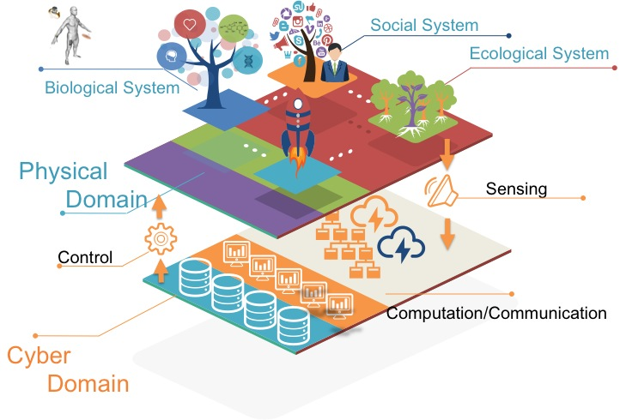
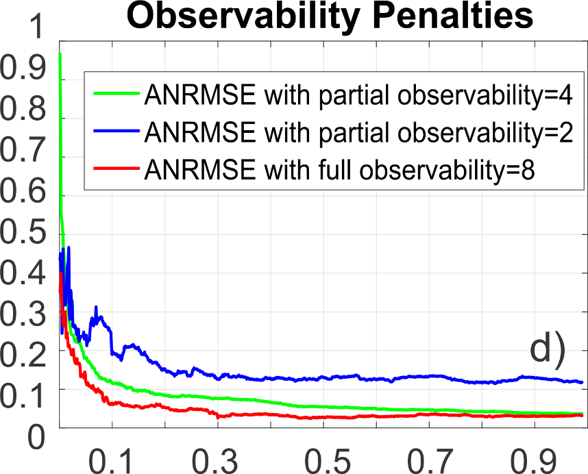
Outline
Challenges for CPS and IoT
Smart mathematical models
Mathematical characteristics of cyber & physical processes
Long-range memory / correlations, non-Gaussian, fractality
Compact mathematical modeling paradigm
Geometric perspective
Asymmetric dynamics
Capturing spatio-temporal complexity
Maximum causal entropy principle
Conclusions and future work
From data to models
From models to more accurate predictions with partial observations

Slide 3
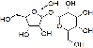
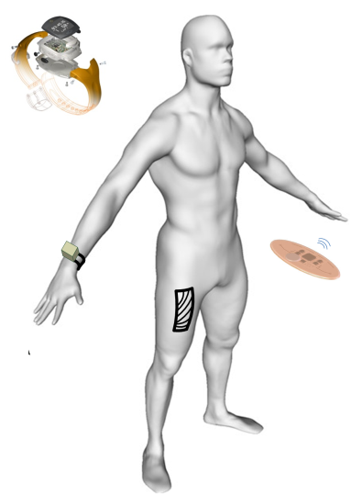

Internet-of-Things (IoT)
IoT raises challenges in cyber-physical systems (CPS), networked sensing, wireless networking, cloud computing
This network-of-networks calls for analytic foundations of IoT
What is the appropriate model capturing mathematical structures of physical and cyber processes ?
What compact yet accurate modeling technique should be developed?
Intelligent Transportation
Smart Cities & Disaster Response Systems
Energy and Sustainability
Smart Health Care
Notes:
From smart cities, to intelligent transportation, to energy systems and healthcare, the IoT provides not only interconnectivity between the physical and cyber world but also a massive amount of data. In each domain and across domains, the generation of data raises the challenge on how we can construct accurate mathematical models that capture the mathematical characteristics of the physical or cyber processes but also enable the prediction and optimization. Throughput the presentation we will review how we can capture through a simple mathematical model the spatio-temporal complexity that exist in these IoT systems.

Slide 4
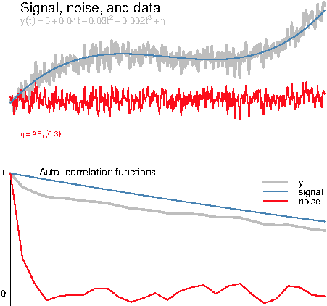
Mathematical Memory
Short-range memory
Autocorrelation function decays exponentially with the lag k
Autoregressive (integrated) moving average AR(I)MA models
order (p,q) for i = 0 (of order (p,i,q) for integer i > 0)
where
Long-range dependence (memory)
Autocorrelation function decays as a power law with the lag k
Fractional autoregressive integrated moving average (FARIMA) models
order (p,d,q) with d the fractional (non-integer) order differencing operator
Paul Doukhan, George Oppenheim, Murad Taqqu, Theory and Applications of Long-Range Dependence, Springer 2002

Slide 5
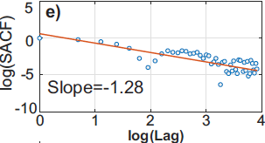
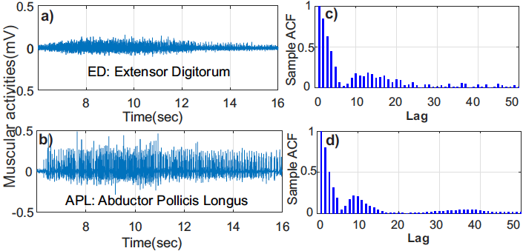
Temporal Complexity: Long-Range Memory
Physical & cyber processes exhibit fractal and long-range dependence (memory) dynamics
Characterized by power-law relations (e.g., autocorrelation function, power spectrum)
Power-law inter-event times due to hierarchical time-weighted feedback loops lead to diverging sums and expectations
Yuankun Xue, Saul Rodriguez, and Paul Bogdan, A spatio-temporal fractal model for a CPS approach to brain-machine-body interfaces, DATE 2016

Slide 6
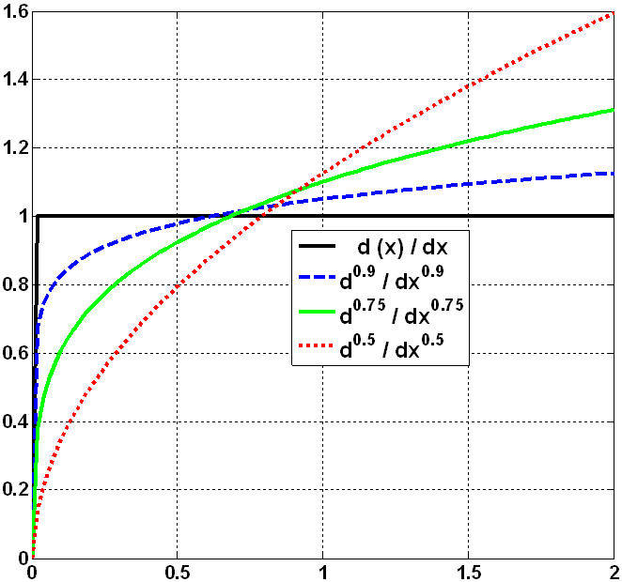
Non-smooth (Non-Differentiable) Dynamics
We are all familiar with powers of a number
x, x², x³, x⁴, x⁵ and so on OR x^{1/2}, x^{1/3}, x^{1/4}, x^{1/5}, …
What about powers (integer, real or complex) of an operator?
Leibniz and L’Hopital raised the question of fractional order derivatives such as d ^{0.5}f(t) / dt ^{0.5}
Fractional Order Derivative :

Slide 7
Exotic Calculus?
Accounting for (long-range) memory leads to fun math!
At least sometimes…
Integer calculus approximation
Fractional (calculus) behavior
x(t)
x(t)
t
t

Slide 8
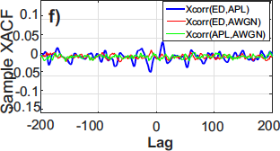
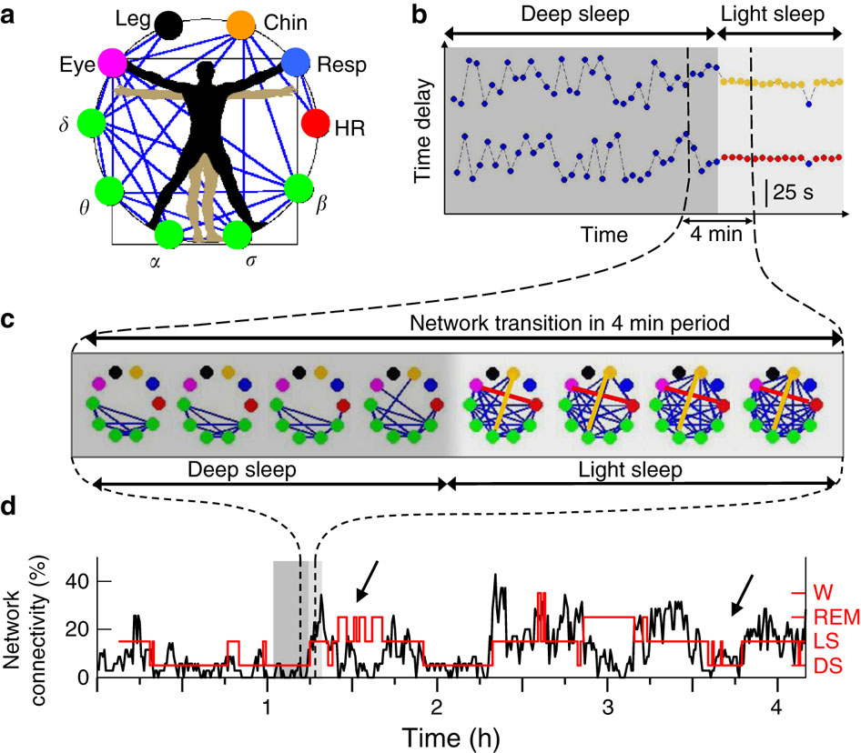
Spatial Complexity: Cross-Dependencies
Cross long-range dependence (LRD)
Quantified via the sample cross-correlation function (SXACF)
SXACF analysis among iEMG signals shows higher values than between the iEMG singal and an additive white Gaussian noise (AWGN)
Interdependent networks are time varying and (sometimes) scale free
Connectivity changes to overcome perturbations and enforce performance and robustness
Bashan et al., Nature Communications, 2012

Slide 9
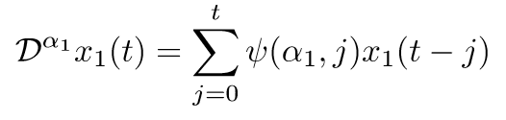
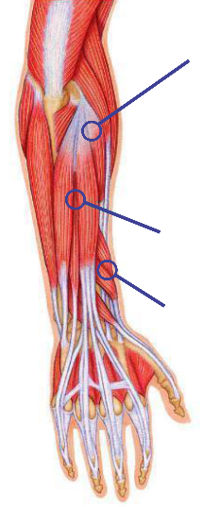
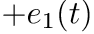
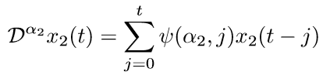
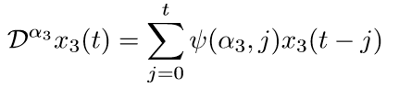
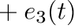
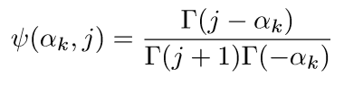
Compact Spatio-Temporal Fractal Model
Long-term temporal dependency
(system free response)
Yuankun Xue, Saul Rodriguez, and Paul Bogdan, A spatio-temporal fractal model for a CPS approach to brain-machine-body interfaces, DATE 2016
Notes:
With combined knowledge of fractality and charateristics,
Go beyond and extend, that better rooted in the nature of
Let us first look at the free response…understand.....
System response
Similar,
Current system, pathways

Slide 10
Compact Spatio-Temporal Fractal Model
Process noise(random turbulence)
Yuankun Xue, Saul Rodriguez, and Paul Bogdan, A spatio-temporal fractal model for a CPS approach to brain-machine-body interfaces, DATE 2016

Slide 11
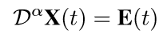
Compact Spatio-Temporal Fractal Model
A matrix form description
Yuankun Xue, Saul Rodriguez, and Paul Bogdan, A spatio-temporal fractal model for a CPS approach to brain-machine-body interfaces, DATE 2016

Slide 12
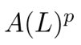
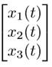
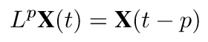
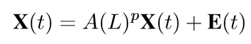
Compact Spatio-Temporal Fractal Model
Consider intercoupling over p steps:
Temporal dependencies
Spatial dependencies
Yuankun Xue, Saul Rodriguez, and Paul Bogdan, A spatio-temporal fractal model for a CPS approach to brain-machine-body interfaces, DATE 2016

Slide 13
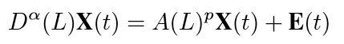
Compact Spatio-Temporal Fractal Model
Temporal dependencies
Spatial dependencies
Compact spatio-temporal fractal (STF) model capturing system dynamics with fewest parameters
Fractional operators capture long-range memory
Coupling matrices capture sparse cross-dependencies

Slide 14
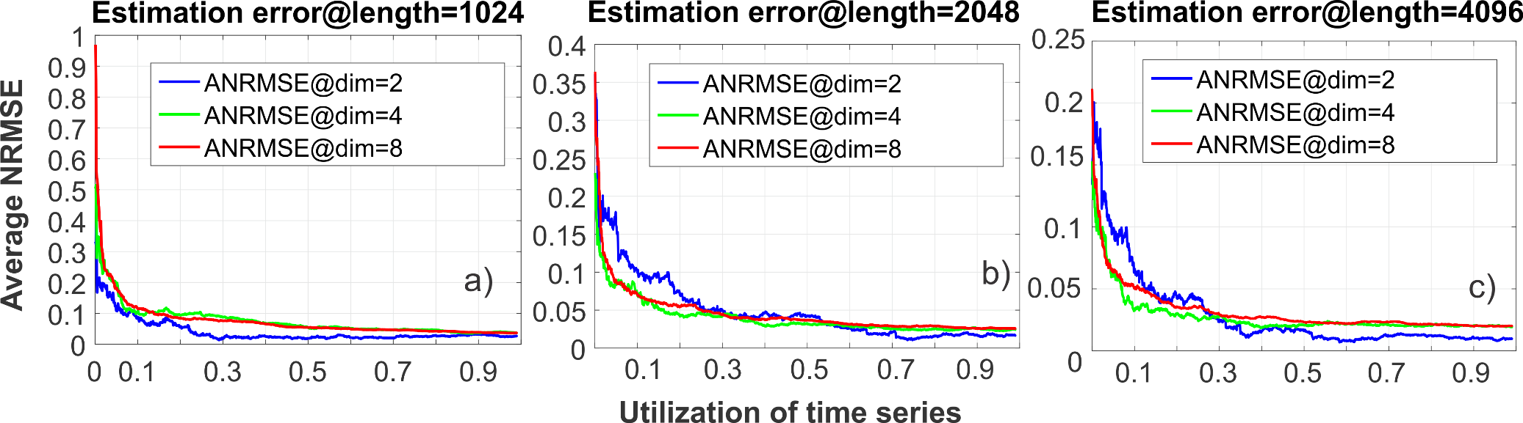
Reliable Identification Under Uncertainty
Consider the STF model to
Generate 2,4,8 time series and produce 1000 trajectories for each
Each time series can have a length of 1024, 2048, or 4096 samples
Estimation errors quantified via the normalized root mean square errors (NRMSE)
Scarcity of data is not a problem
Accuracy of the identification algorithm exhibits a phase transition as a function of percentage of missing samples
Phase transition
Phase transition
Phase transition

Slide 15
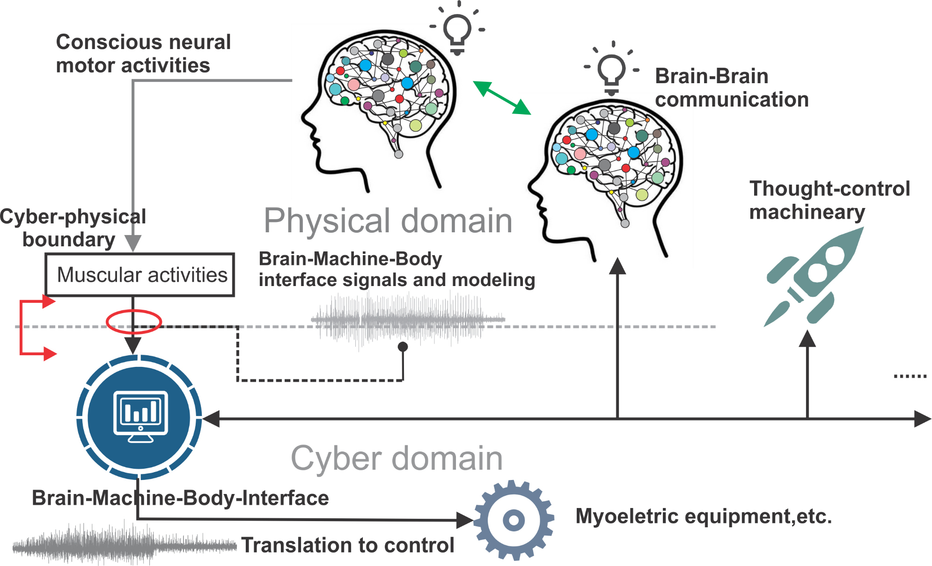

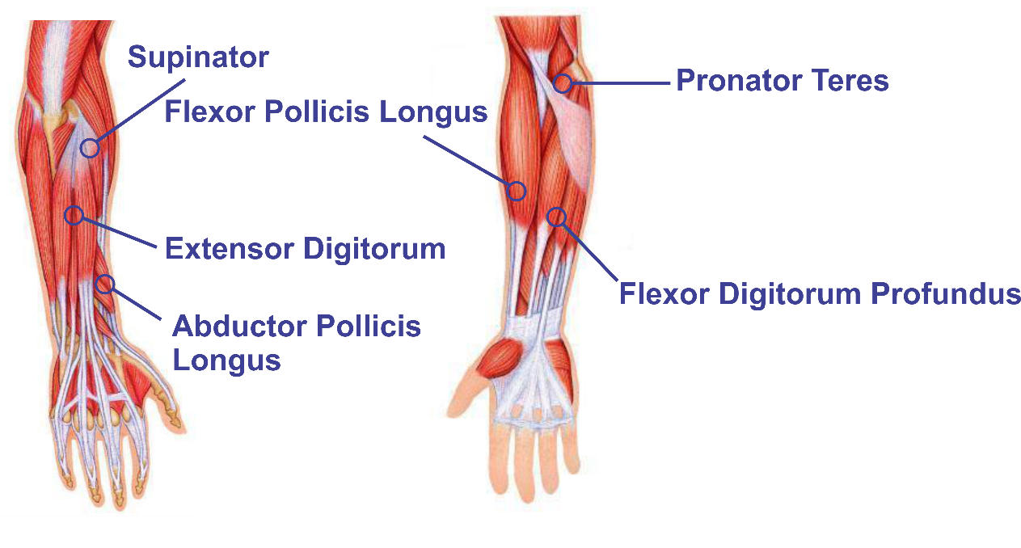
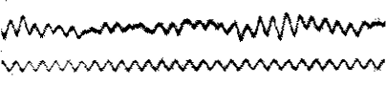
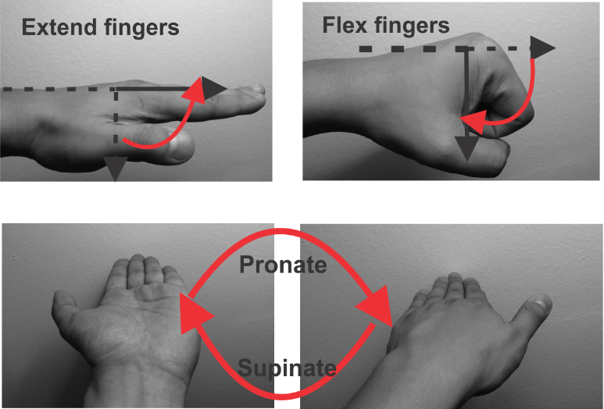
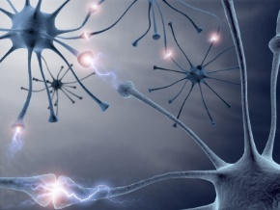
Complex Interdependent Networks
Brain-machine-body interfaces need to sense, decode and control multiple complex interdependent networks
Upper motor neuron
Major forearm muscles
Lower motor neuron in spinal cord
Neural-muscular junction

Slide 16
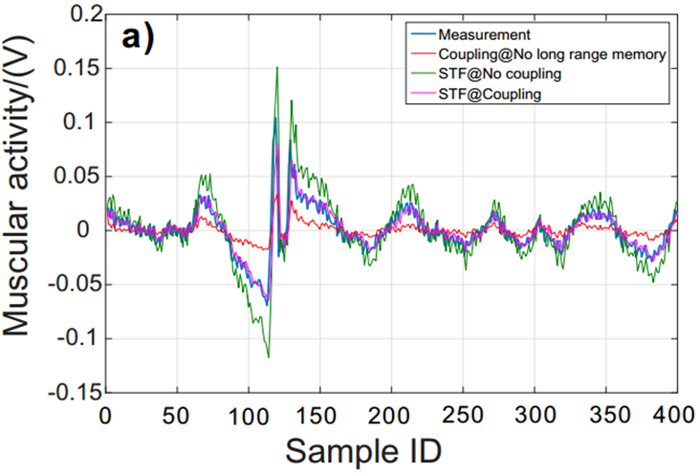
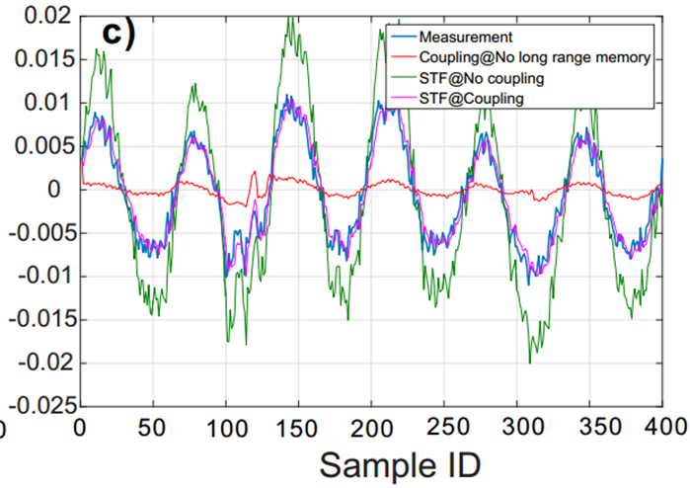
Spatio-Temporal Modeling Matters!
Consider three different models
Spatio-temporal fractal (STF) model with memory and coupling between physiological processes (i.e., STF with coupling)
STF model with no spatial coupling (uses the identity matrix as dependency matrix)
a model with only the spatial coupling (i.e., the coupling with no long-range memory)
Accounting with fewest parameters for memory and cross-dependencies leads to better accuracy
extensor digitorum (ED)
supinator

Slide 17
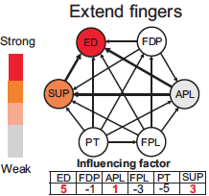
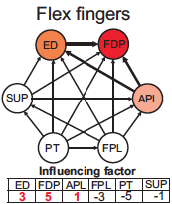
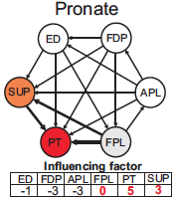
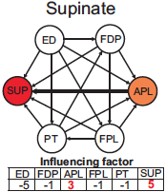
Muscular Networks
Setup
3 healthy subjects asked to
Extend all fingers at a consistent strength for 10 seconds
Flex all fingers at a consistent strength for 10 seconds
Pronate forearm
Supinate forearm
Connectivity
Constructed by performing a t-test with the null hypothesis
Few dominant muscles for an action
Demonstrates consistency with clinical & anatomical observations
Yuankun Xue, Saul Rodriguez, and Paul Bogdan, A spatio-temporal fractal model for a CPS approach to brain-machine-body interfaces, DATE 2016

Slide 18
A Geometric Perspective: Stochastic
x(t)
Magnitude of negative increments in the stochastic process x(t)
Magnitude of positive increments in the stochastic process x(t)
t
Inter-event time t₂-t₁ = Δt
Analysis of the magnitude of positive and negative increments in the stochastic process
dictates the degree of nonlinearity / confidence in linearity assumption
Analysis of inter-event times distribution
dictates whether the stochastic process has short-range or long-range memory

Slide 19
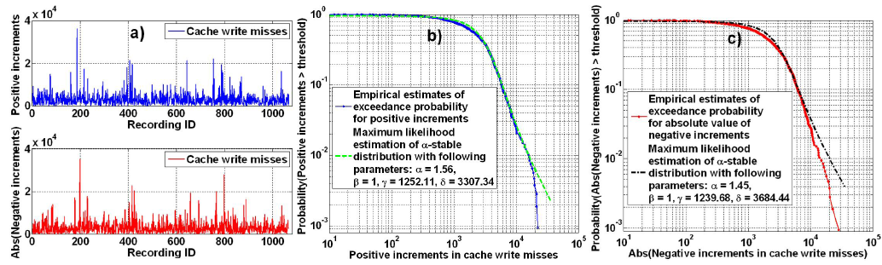
Magnitude Increments Matter!
Statistical properties of increments determine the degree of linearity / nonlinearity
Exponentially distributed increments indicate an almost linear behavior
Stochastic processes can display an asymmetric dynamics
Statistical properties of positive and negative magnitude increments can be different leading to a radically new dynamic equation

Slide 20
Current Modeling Approaches
x(t)
ARMA(1,1):
or
ARMA(p,q):
t
ARIMA(p,d,q):
Ignoring mathematical (statistical) characteristics of data can lead to complex models
Capturing long-range memory does not need more parameters but rather smart modeling techniques
Nonlinearities must be identified and modeled through fewest parameters possible

Slide 21
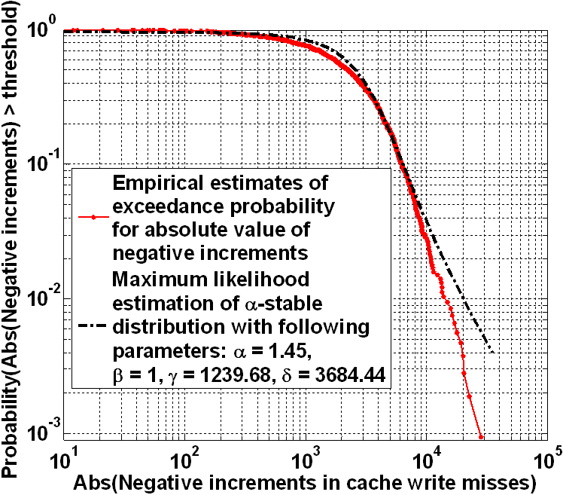
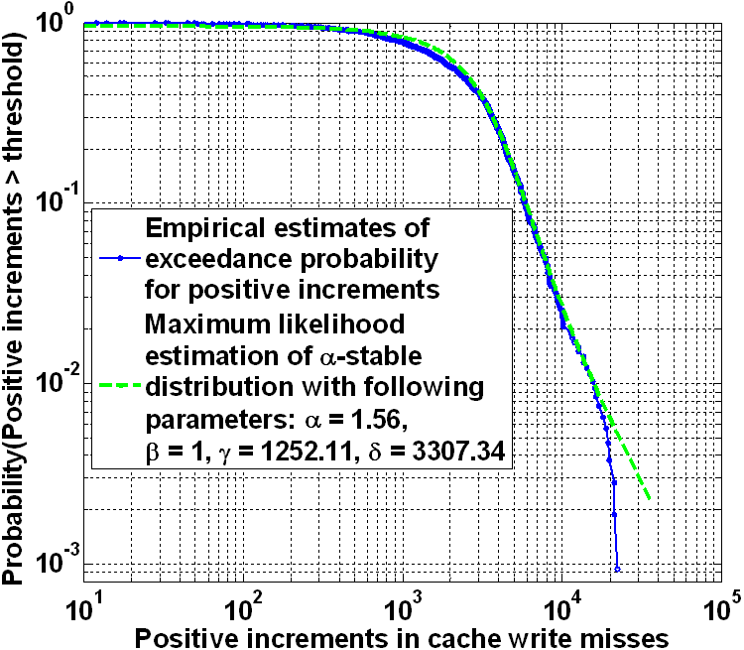
Data-Driven Modeling – Learning From Data
Quantify probability P(x,t|α,β) of process x(t) (workload)
to attain value x at time t whose magnitude increments and inter-event times are characterized by fractal dimensions α and β
Initial condition
Coupling between negative increments and their inter-event times
Coupling between positive increments and their inter-event times

Slide 22
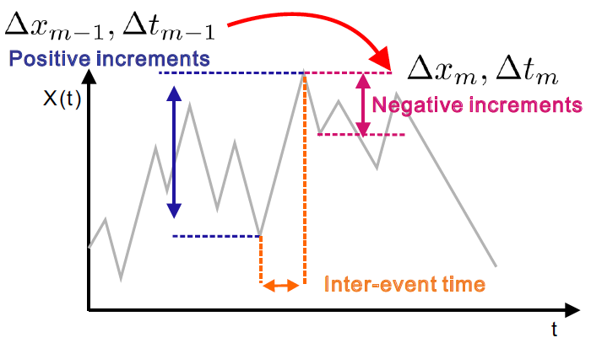
Maximum Causal Entropy Principle
How to estimate w(Δx, Δt)?
subject to
Power law family of solutions
Essential is a relative gain / regret time-directional entropy
Yuankun Xue and Paul Bogdan, Constructing Compact Causal Mathematical Models for Complex Dynamics, to appear in April 2017

Slide 23
Capturing Asymmetry
Riesz-Feller fractional order derivative
0 < α < 2, linked to the asymmetric α-stable distribution
θ – is the skewness parameter measuring the symmetry

Slide 24
Multi-Fractal Space-Time Modeling (MFST)
Employing fractional calculus concepts
Riemann-Liouville fractional order integral and derivative
Allows to describe the evolution of the probability P(x,t) via a multi-fractional space-time Fokker-Planck equation:
Where
h(β) – distribution of fractal exponents characterizing the inter-event times
g(α) – distribution of fractal exponents characterizing the magnitudes

Slide 25
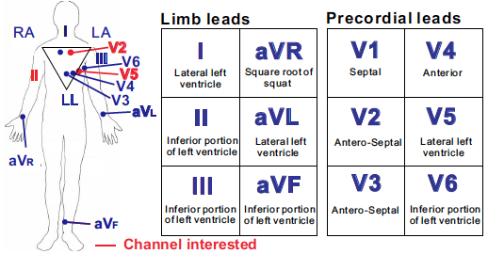
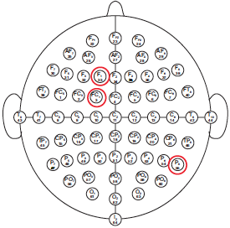
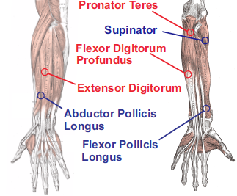
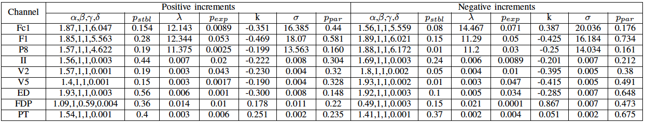
Physiological Processes - Results
Two-sample Kolmogorov-Smirnov test
Returns a test decision for the null hypothesis that two trajectories are from the same continuous distribution
Exponential distribution does not fit well the positive and negative increments
Asymmetric dynamics
Positive increments fitted better by α-stable dist.
Negative increments fitted better by Pareto dist.

Slide 26

Conclusions and Future Work
Current work
Developed a data-driven mathematical modeling of complex interdependent networks
Capture degree of long-range memory for each cyber or physical process
Capture the time varying interdependency between various processes
Demonstrated the benefits of proposed data-driven mathematical modeling and multi-fractional formalism for brain-muscle interdependent networks
Future work
Derive bounds and algorithms for determining the minimal requirements for observability / sensing and controlability
Thank you!
More info at http://ceng.usc.edu/cps/

